Slide 1
Diabetes Prediction using Machine Learning at Stark Health Clinic
DORCAS ADEWUNI
FEB, 2024
Github: DeeSpinel/Diabetes-Prediction

Slide 2

Business Introduction
Stark Health Clinic is a leading healthcare provider using AI & predictive analytics.
Mission :- To improve early disease detection using machine learning.

Slide 3
Problem Statement
Diabetes poses serious health risks to Stark Health’s patients.
Current detection methods is not working accurately, which led to missed early intervention.
Financial cost is on the high side for Stark hospital, due to late diagnoses. And complications.

Slide 4

Project Rationale
Accurate predictive models can reduce healthcare costs.
Early intervention improvement.
Helps doctor take proactive measures before any issue arise.

Slide 5
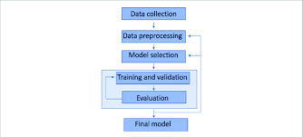
Project Objective
build diabetes prediction model.
Identify high risks for early treatment
Resource optimization and reduces long term costs.

Slide 6
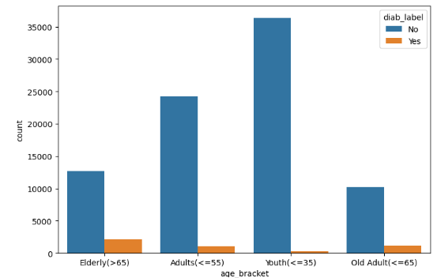
Data Understanding and processing
100k entries and 9 columns (gender,age,bmi,HbA1c level, blood glucose level, heart disease, hypertension, smoking history, diabetes(target)).
CRISP-DM (Data understanding, Data cleaning, EDA, data scaling, modelling, evaluation)
This analysis gives an insight: the older population have diabetes more, than the younger population.

Slide 7
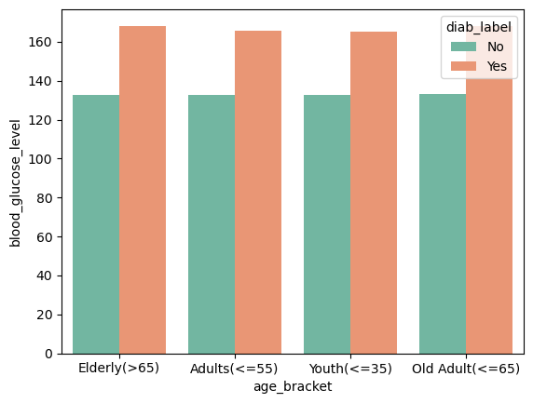
Exploratory Data Analysis
the difference between diabetic and non-diabetic across all age bracket is consistent.
non-diabetic persons have a stable blood glucose level across all ages
Diabetic persons have higher blood glucose level, around >=163

Slide 8
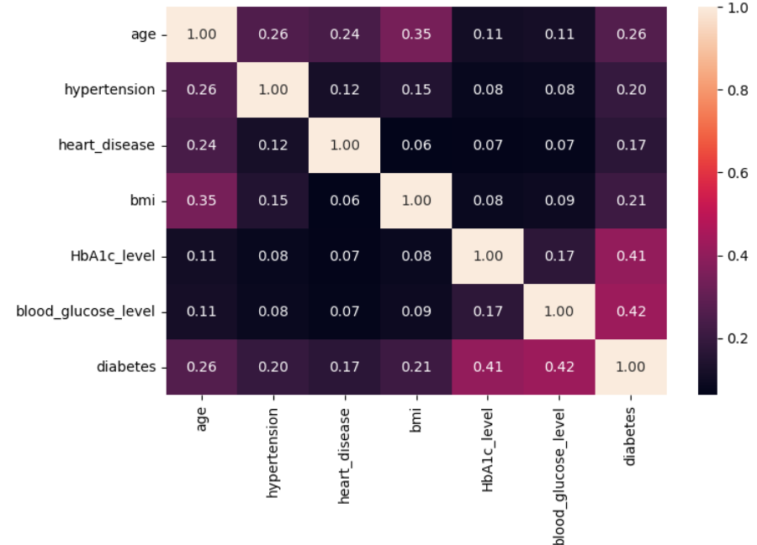
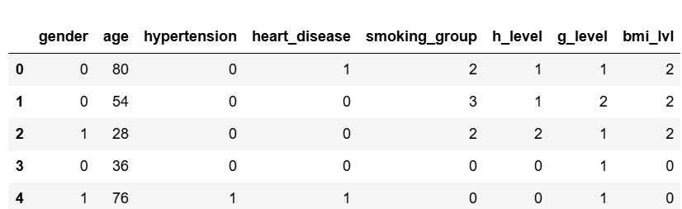
Preprocessing
Feature Engineering
Categorical Encoding
Train and Test split of data
Model training
Correlation

Slide 9
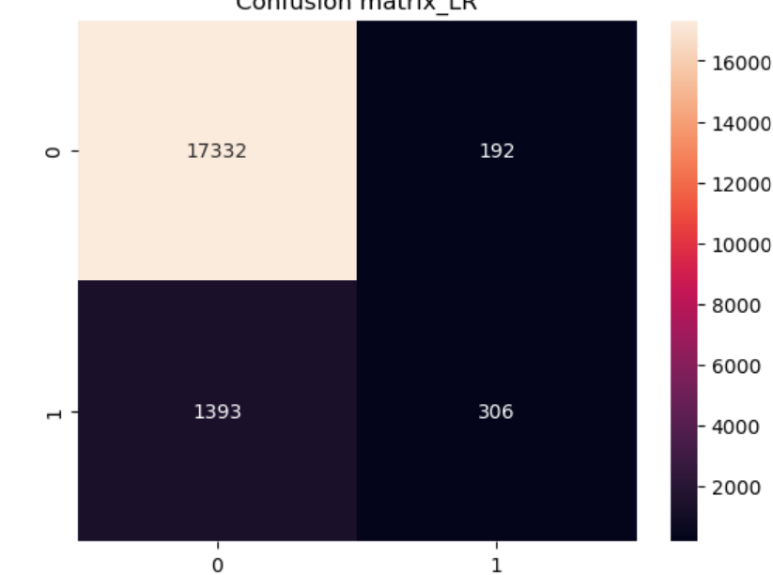
Model Evaluation Before balancing
Logistic Regression model performed best
The model correctly predicted no diabetes(class 0) 17332 cases. True Negative.
model incorrectly predicted diabetes for non diabetic persons, 192 cases. (False Positive)
the model missed 1,393 actual diabetes cases, predicting them as no diabetes. (False Negative)
Model correctly predicted 306 cases to be diabetes for actual diabetic persons. (True Positive)

Slide 10
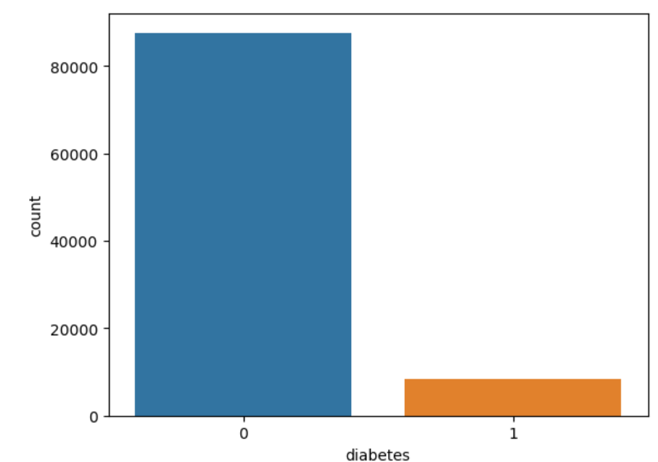
Data Balancing
Distribution of the dataset
Before balancing, the dataset had 17,524 non-diabetic cases (0) and only 1,699 diabetic cases (1). This led to poor recall for detecting diabetes.
Methods used in Balancing the data
Class weights approach
SMOTE (Synthetic Minority Over-sampling Technique)

Slide 11
Data Balance Methods
Class weights
SMOTE
Higher weight was assigned to the minority class (diabetes cases).
Class weight was set to {0:1,1:4}
It will encourage the model to correctly identify more diabetic cases.
Improve the recall (fewer false negatives)
Generates artificial samples through identifying the nearest neighbour of minority class point.
Prevents the model from ignoring the minority class.
 | Precision(1) | Recall(1) | F1 score(1)
Before Class Weight | 59 | 48 | 53
After class weight | 49 | 60 | 54
SMOTE | 92 | 92 | 92

Slide 12
Model Perfomance
Models | Accuracy | Precision | Recall | F1 score
Logistic Regression | 78 | 77 | 79 | 78
Naïve Bayes | 78 | 84 | 68 | 76
Random Forest | 92 | 92 | 92 | 92
XGBoost | 91 | 90 | 93 | 91
Random Forest had the best overall balance (high recall and precision).
Logistic regression model improved with SMOTE
Naïve bay struggles with the synthetic data.
XGBoost also has a good balance.

Slide 13
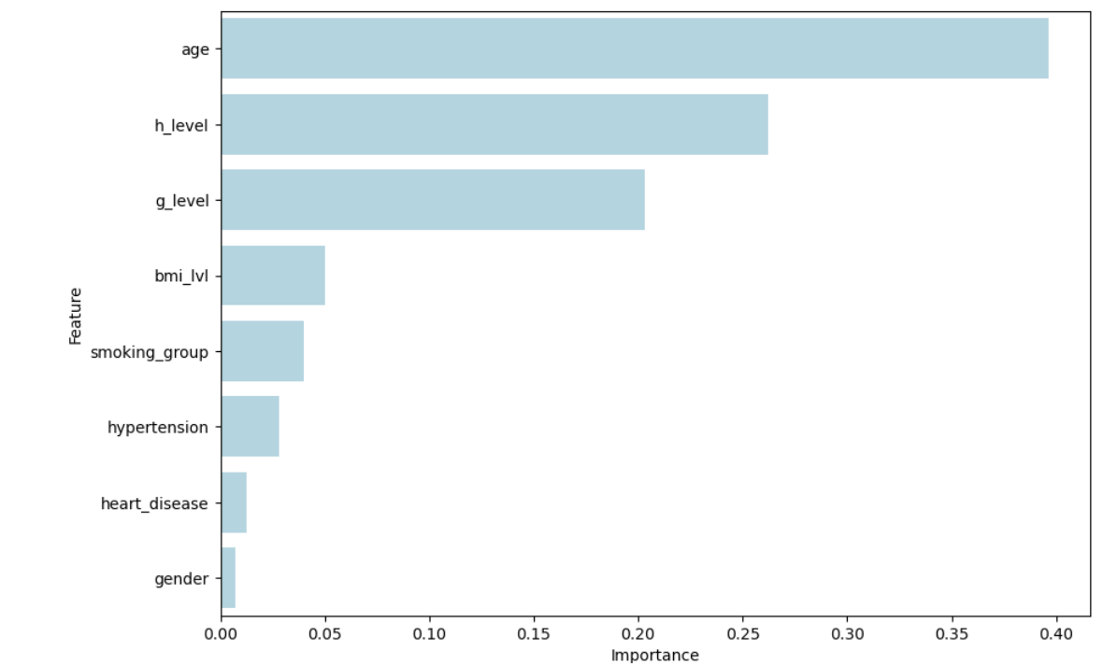
Feature Selection: model interpretability
Age is the most influential feature, indicating that older individuals are more likely to develop diabetes.
h_level (HA1c level) and g_level (glucose level) are strong predictors, which aligns with medical knowledge about diabetes risk factors.
BMI level, smoking group, and hypertension have moderate importance, suggesting lifestyle and health conditions play a role.
Gender, heart disease, and hypertension have the least influence, meaning they contribute less to the model’s predictions.

Slide 14
Key Findings
Data Imbalance was a challenge.
Feature Importance & Selection suggests we can remove least important features to improve efficiency.
Model performance after balancing. Random Forest have a stronger performance (92% accuracy), suggesting tree-based models handle this dataset well.

Slide 15
Recommendations
Using SHAP for future feature importance and interpretability.
Check data well for missing data and duplicates and outliers that could affect model accuracy.
SMOTE worked well for data balancing, I recommend.
Implementing the model in a clinical decision support system

